Slide 1


HelloWorld – User interface
Build a basic with

Slide 2
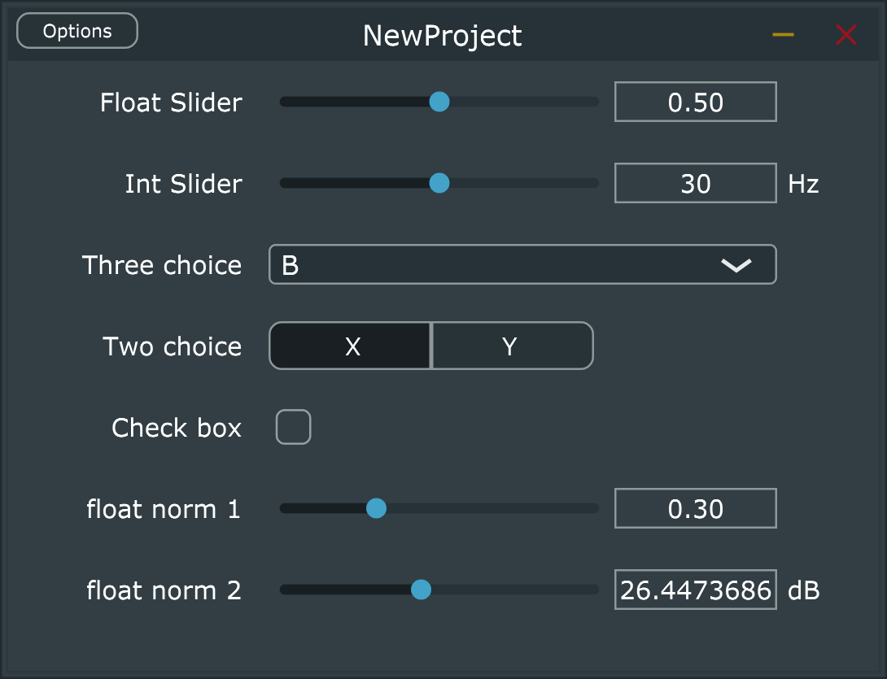
Generic Audio Processor Editor
Use generic audio processor UI for simple UI design in JUCE
Can add UI elements like sliders and boxes to a plugin
Displays AudioProcessor’s parameters as sliders, combo boxes and switches
Can show editor for a processor that doesn't supply its own custom editor
See https://docs.juce.com/master/classGenericAudioProcessorEditor.html
Notes:
The GenericAudioProcessorEditor is a user interface component that displays the parameters of an AudioProcessor as a simple list of sliders, combo boxes and switches. It will also automatically lay out the controls on an interface. Here, we will use it to greatly simplify the user interface design and control., allowing us to focus mainly on the audio-related aspects.

Slide 3
Modifying the code
Replace
return new HelloWorldv1AudioProcessorEditor (*this);
With
return new juce::GenericAudioProcessorEditor(this);
So plugin will use generic user interface provided with JUCE library
Open PluginProcessor.h file, add this variable to the private section;
juce::AudioParameterFloat* gainParam;
In PluginProcessor.cpp constructor, add slider to change this variable.
addParameter(gainParam = new juce::AudioParameterFloat("gain","Gain",0.0f,1.0f,0.0f));
gainParam references the AudioParameterFloat we created in PluginProcessor.h.
gain is the slider’s ID
Gain will be shown next to the slider in the DAW.
Float values set minimum, maximum, and default values for the slider
Notes:
For our plugin to use this generic interface, we replace the line
return new HelloWorldv1AudioProcessorEditor (*this);
With
return new juce::GenericAudioProcessorEditor(this);
We then Open PluginProcessor.h file, add this variable to the private section;
juce::AudioParameterFloat* gainParam;
In PluginProcessor.cpp constructor, add slider to change this variable.
addParameter(gainParam = new juce::AudioParameterFloat("gain","Gain",0.0f,1.0f,0.0f));
gainParam references the AudioParameterFloat we created in PluginProcessor.h.
gain is the slider’s ID
Gain will be shown next to the slider in the DAW.
Float values set minimum, maximum, and default values for the slider

Slide 4
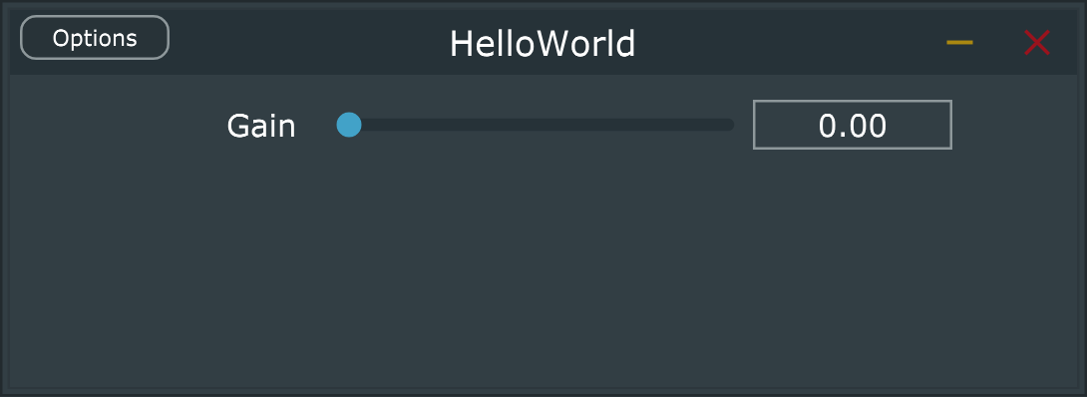
Applying gain
We now have a slider on the interface ☺
But it doesn’t do anything
Modify code in processBlock to be
float gainValue = gainParam->get();
for (int channel = 0; channel < getTotalNumOutputChannels(); ++channel)
{
auto* channelData = buffer.getWritePointer(channel);
for (int sample = 0; sample < buffer.getNumSamples(); sample++)
{
channelData[sample] = gainValue * (2 * ((double)rand() / (RAND_MAX)) - 1.0);
}
}
Build and run it again
Now have user control ☺ ☺
Notes:
We now have a slider on the interface, but it doesn’t do anything. So modify the code in the processBlock to be
float gainValue = gainParam->get();
for (int channel = 0; channel < getTotalNumOutputChannels(); ++channel)
{
auto* channelData = buffer.getWritePointer(channel);
for (int sample = 0; sample < buffer.getNumSamples(); sample++)
{
channelData[sample] = gainValue * (2 * ((double)rand() / (RAND_MAX)) - 1.0);
}
}
Build and run it again. Now we have user control.

Slide 5
See Generic UI project for more on coding a generic interface
Creates different looking UI objects for different parameters
addParameter(floatParam = new juce::AudioParameterFloat
("FLOATPARAM", "Float Slider", 0.0f, 1.0f, 0.5 f));
addParameter(intParam = new juce::AudioParameterInt
("INTPARAM", "Int Slider", 20, 40, 30, "Hz"));
addParameter(choice3Param = new juce::AudioParameterChoice
("THREECHOICE", "Three choice", { "A", "B", "C"}, 1));
addParameter(choice2Param = new juce::AudioParameterChoice
("TWOCHOICE", "Two choice", { "X", "Y" }, 0));
addParameter(boolParam = new juce::AudioParameterBool
("BOOL", "Check box", false));
addParameter(floatNorm1Param = new juce::AudioParameterFloat
("FLOATN1", "float norm 1", { 0.0f, 1.0f, 0.01 }, 0.3f));
addParameter(floatNorm2Param = new juce::AudioParameterFloat
("FLOATN2", "float norm 2", { 0.0f, 60.0f, 0.0f, 1.0f }, 0.f, "dB"));
Notes:
From JUCE
AudioParameterFloat
AudioParameterInt
AudioParameterChoice
AudioParameterBool

Slide 6
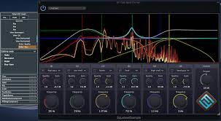
Beyond the generic user interface
Generic UI only intended for prototyping
Lets make a real UI
Add a control
Add a parameter value based on the control
Update parameter when control is changed
Show the control on the interface
Use the parameter somehow

Slide 7
Add a slider
Go back to HelloWorld before generic UI
So we will use the default editor
Add a slider in pluginEditor.h
Add a float in pluginProcessor.h
class NewProjectAudioProcessorEditor : public juce::AudioProcessorEditor, private Slider::Listener
{
…
private:
Slider gainSlider;
class NewProjectAudioProcessor : public juce::AudioProcessor ...
{
…
float gainParam = 0.1f;
private:

Slide 8
Changing the slider
Add a function in the editor
//PluginEditor.h
void sliderValueChanged(Slider* slider);
//PluginEditor.cpp
void NewProjectAudioProcessorEditor::sliderValueChanged(Slider* slider) {
audioProcessor.gainParam = gainSlider.getValue();
}

Slide 9
Put the slider on the interface
Now edit the constructor in pluginEditor.cpp
And edit resized
NewProjectAudioProcessorEditor::NewProjectAudioProcessorEditor (NewProjectAudioProcessor& p)
: AudioProcessorEditor (&p), audioProcessor (p)
{
setSize (400, 300);
gainSlider.setRange(0.0, 1.0, 0.01);
gainSlider.setValue(0.5);
gainSlider.setTextBoxStyle(Slider::TextBoxLeft, false, 60, 30);
addAndMakeVisible(&gainSlider);
gainSlider.addListener(this);
}
void NewProjectAudioProcessorEditor::resized()
{
gainSlider.setBounds(40, 30, 160, 50);
}

Slide 10
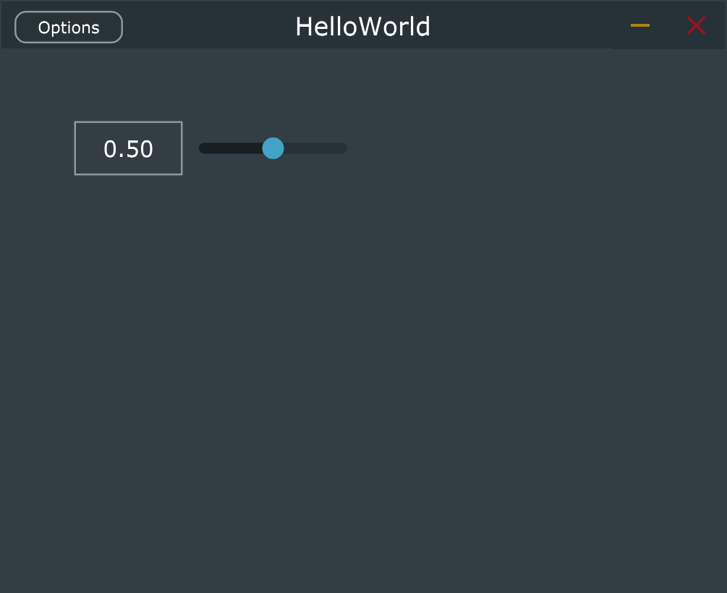
Use the slider
We now have a slider on the interface ☺
So far, this gain slider doesn’t do anything.
Modify the code in the processBlock to be
Just like with the Generic UI, but we now have a separate callback for changes to the gain slider
void NewProjectAudioProcessor::processBlock (juce::AudioBuffer<float>& buffer, juce::MidiBuffer& midiMessages)
{
auto totalNumOutputChannels = getTotalNumOutputChannels();
for (int channel = 0; channel < totalNumOutputChannels; ++channel)
{
auto* channelData = buffer.getWritePointer (channel);
for (int i = 0; i < buffer.getNumSamples(); i++) {
channelData[i] = gainParam * (2 * (float)rand() / RAND_MAX - 1);
}
}
}

